Slide 1
Mobile robot’s controller

Slide 2
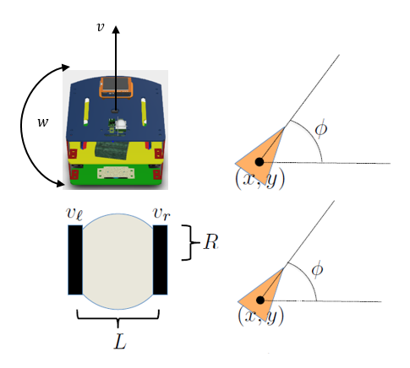
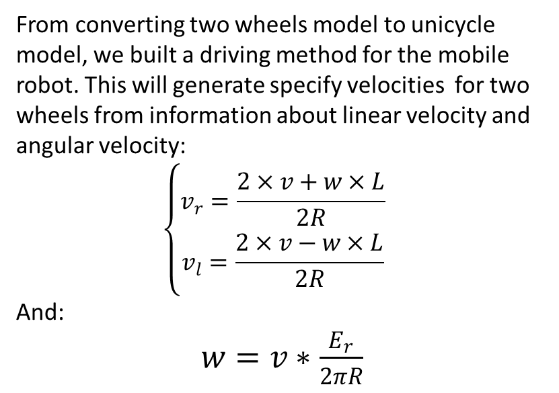
Driving method
From converting two wheels model to unicycle model, we built a driving method for the mobile robot. This will generate specify velocities for two wheels from information about linear velocity and angular velocity:
$$\left\{\begin{aligned}v_{r}=\frac{2×v+w×L}{2R} \\ v_{l}=\frac{2×v−w×L}{2R}\end{aligned}\right.$$
And:
$w=v∗\frac{E_{r}}{2πR}$
Unicycle model

Slide 3
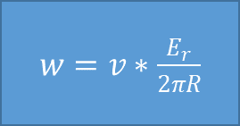
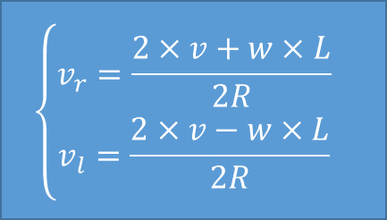
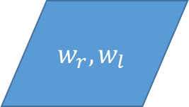
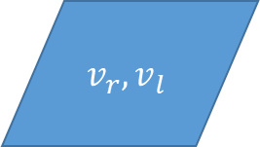
Driving method
Start
$$\left\{\begin{aligned}v_{r}=\frac{2×v+w×L}{2R} \\ v_{l}=\frac{2×v−w×L}{2R}\end{aligned}\right.$$
Receiving input
v (linear velocity) , w (angular velocity)
Send to system’s controller
$$w_{r}, w_{l}$$
$w=v∗\frac{E_{r}}{2πR}$
$$v_{r}, v_{l}$$
System call to stop?
no
yes
End

Slide 4
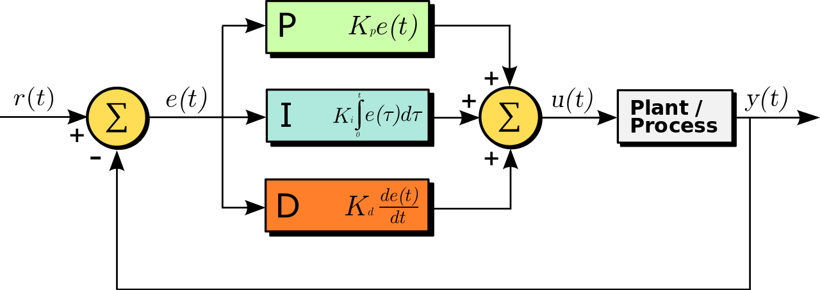
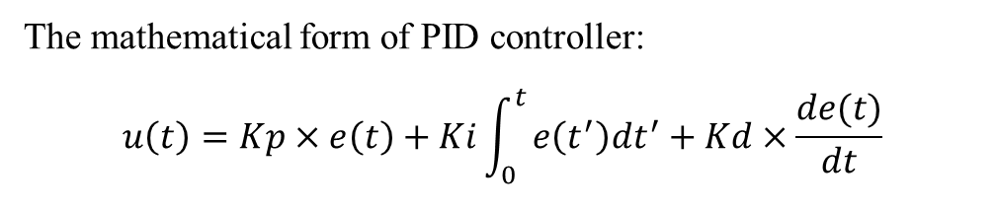
System’s controller
PID with auto-tuning by Relay method
The mathematical form of PID controller:
$$u\left(t\right)=Kp×e\left(t\right)+Ki\int_{0}^{t}{e\left(t^{′}\right)dt^{′}+Kd×\frac{de(t)}{dt}}$$

Slide 5
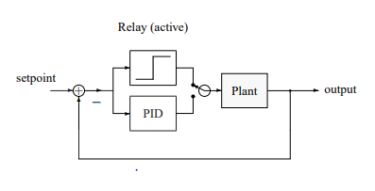
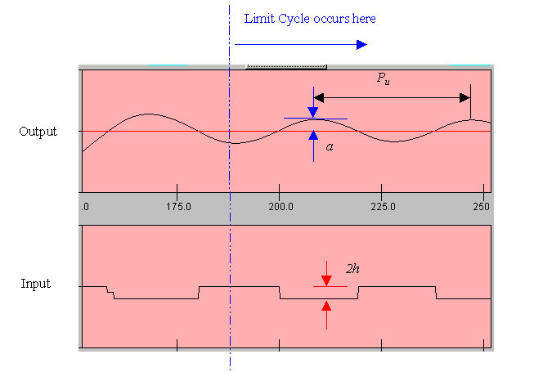
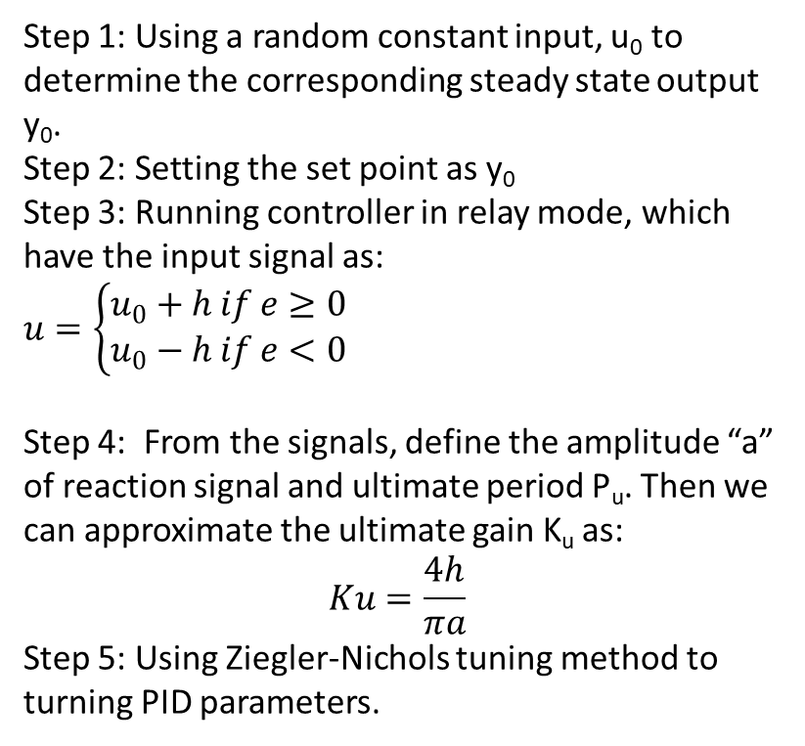
System’s controller
PID with auto-tuning by Relay method
Step 1: Using a random constant input, u₀ to determine the corresponding steady state output y₀.
Step 2: Setting the set point as y₀
Step 3: Running controller in relay mode, which have the input signal as:
$u=\left\{\begin{aligned}u_{0}+h if e≥0 \\ u_{0}−h if e<0\end{aligned}\right.$
Step 4: From the signals, define the amplitude “a” of reaction signal and ultimate period P_{u}. Then we can approximate the ultimate gain K_{u} as:
$$Ku=\frac{4h}{πa}$$
Step 5: Using Ziegler-Nichols tuning method to turning PID parameters.

Slide 6
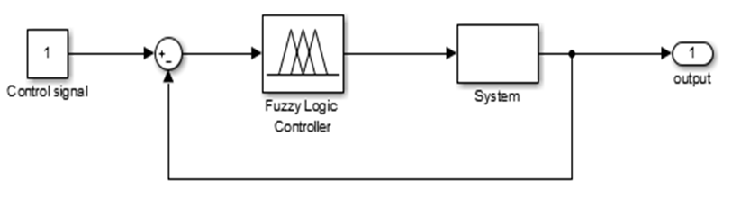
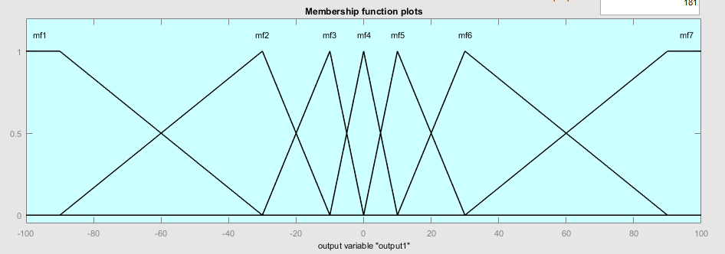
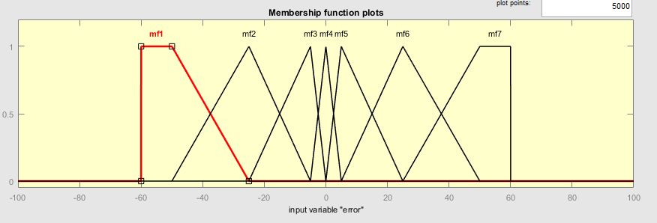
System’s controller
Fuzzy controller
Fuzzy controller
Output membership function
Input membership function

Slide 7
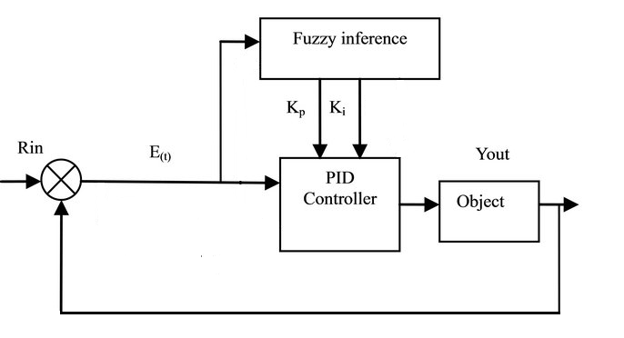
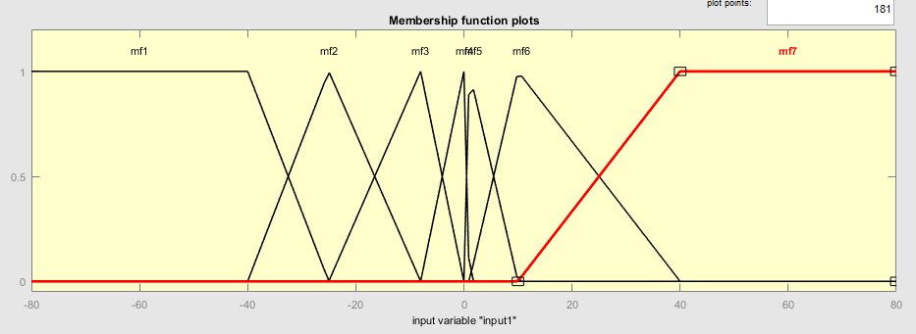
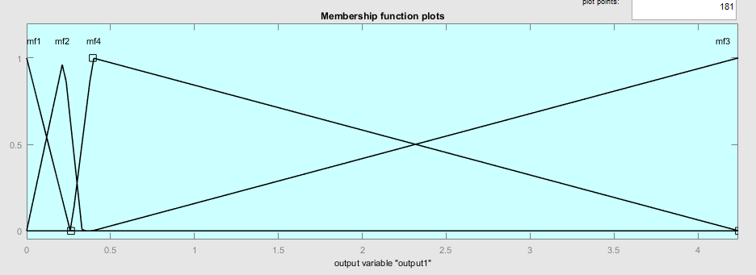
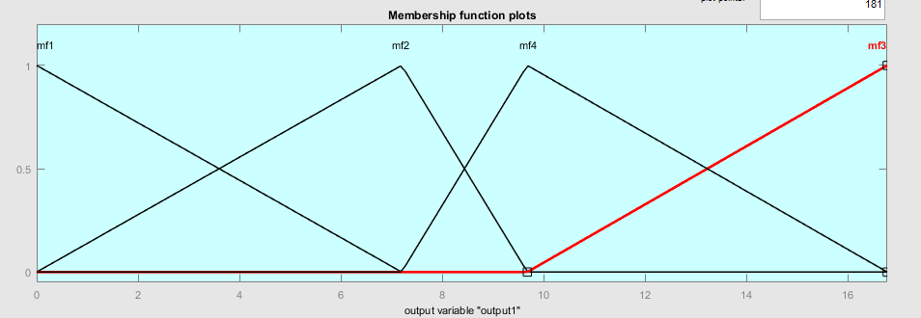
System’s controller
Self tuning Fuzzy-PID
Self-tuning Fuzzy PID Controller
Fuzzy’s input: Error
Fuzzy logic’s Output member function: Kp (left) and Ki (right)

Slide 8
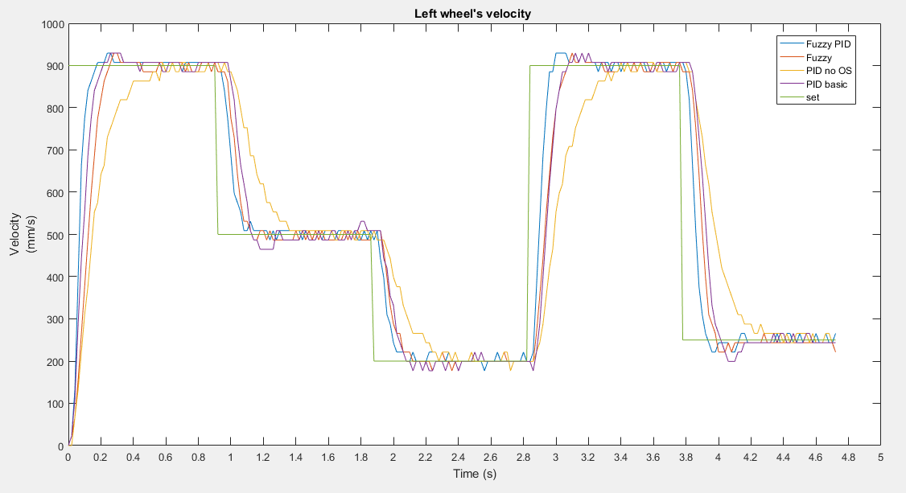
System’s controller
Result & Comparing
Comparing controllers

Slide 9
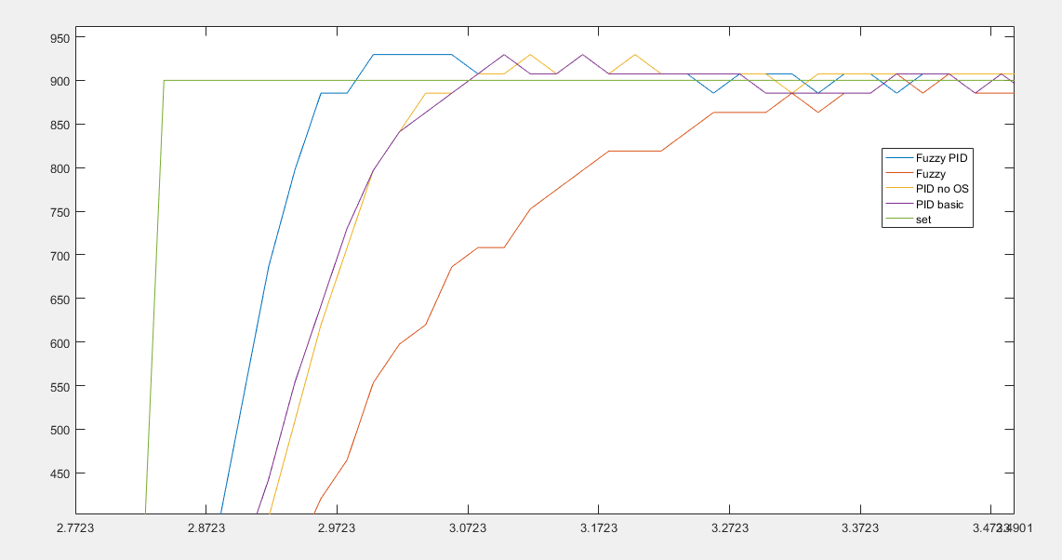
System’s controller
Result & Comparing
Comparing controllers

Slide 10
System’s controller
Conclusion
Self-tuning Fuzzy PID Controller is the most suitable controller comparing with Fuzzy controller and PID controller. Following the comparison, it has the lower peak time and settling time than the other. Overshoot also less than PID, and stability are similar with Fuzzy controller. Also the wind-up problem is minimize, and the system working process is smoothly.
We decided to apply this controller to our mobile robot in this project.

